Slide 1
Carbon Cycle
The circulation of carbon on earth in which atmospheric carbon dioxide is converted to organic nutrients through photosynthesis and is again converted back to the inorganic state by respiration, decay, or combustion. The atmosphere, the oceans, vegetation, rocks, and soil forms the major carbon reserve of our planet.
Antoine Lavoisier and Joseph Priestley discovered the carbon cycle in the 18th century.

Slide 2
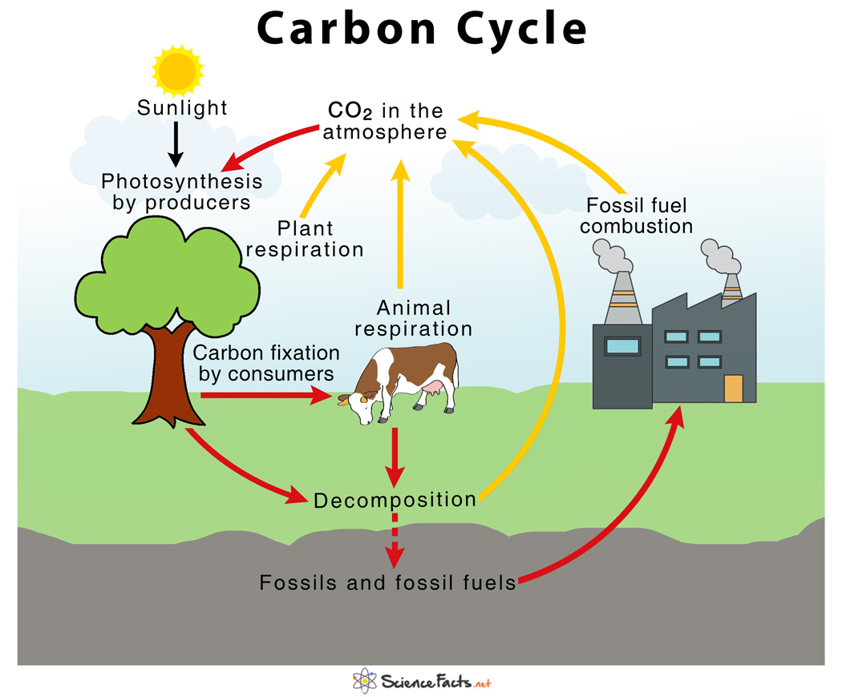

Slide 3
Major Steps of the Carbon Cycle:
1. Role of Primary Producers (Photosynthesis and Cellular Respiration)
Carbon present in the air as carbon dioxide is absorbed by plants, the primary producers to produce food in the form of carbohydrates by a process called photosynthesis. This forms the foundation of the carbon cycle.
Respiration by plants returns carbon dioxide to the atmosphere, thus once again contributing to the cycle in a different manner.
2. Role of Primary Consumers (Carbon Fixation and Cellular Respiration)
The primary consumers such as cows and horses use plants as their food, and carbon gets accumulated and fixed into their bodies in the form of organic carbon, a process known as carbon fixation.
Respiration by animals release carbon dioxide back to the atmosphere.

Slide 4
3. Role of Detritus Feeders (Decomposition)
Once plants and animals die, the fixed organic carbon is released back into the atmosphere as carbon dioxide gas through decomposition by the detritus feeders.
4. Role of Fossils and Fossil Fuels (Combustion)
The carbon that is leftover in the body of the dead organisms after decay becomes fossil fuels over many years, which on combustion releases the carbon stored in them back to the atmosphere thus completing the cycle.

Slide 5
Importance of Carbon Cyce:
1) Primary Function of the Carbon Cycle: To maintain the balance of carbon in nature. Since atmospheric carbon dioxide determines the rate of photosynthesis by the producers, which acts as the primary source of food production on earth, the carbon cycle helps to sustain life on earth.
2) Other Roles in Living Systems and the Environment:
i) Carbon forms an integral component of proteins, lipids, and DNA, the building blocks of all living things
ii) Carbon dioxide traps the long-wavelength radiations from the sun and prevents it from escaping into space, very much like the glass walls of a greenhouse, thus acting as a blanket over the planet and controlling the temperature of the earth.

Slide 6
Effect of Humans activities on the Carbon Cycle:
Human activities can interfere with the carbon cycle in two possible ways –
1) Combustion of fossil fuels like coal, petroleum, and natural gases
2) Indiscriminate cutting of trees or deforestation
Effects of Combustion of Fossil Fuels on the Carbon Cycle:
Burning of fossil fuels releases excess carbon dioxide in the atmosphere, which is way more than the amount removed by plants during photosynthesis. This results in an increase in atmospheric carbon dioxide, thus disturbing the balance of the carbon cycle.

Slide 7
Effect of Deforestation on the Carbon Cycle:
As trees and forests balance the amount of carbon in the atmosphere through photosynthesis, excessive cutting of trees increases the carbon dioxide level in the atmosphere, thus raising the temperature of the earth. This is one of the primary reasons for the negative greenhouse effects and global warming.

Slide 8
Sulphur Cycle
The sulfur cycle is a biogeochemical cycle in which the sulphur moves between rocks, waterways and living systems.
Sulphur is mainly found on earth as sulphates in rocks or as free sulphur and salts burried in depths of ocean.
sulphur and its compounds are important element of industrial processes.
sulfur is an essential element (CHNOPS), being a constituent of many proteins and cofactors, and sulfur compounds can be used as oxidants or reductants in microbial respiration.

Slide 9
Plants absorbs sulphur in the form of sulfate ions (SO₄⁻²) and converted it into organic forms.
Sulfur is present in some amino acid like methionine and cysteine.
The 10th most abundant element in the environment.
Used for the things such as fertilizers, matches and insecticides etc.

Slide 10
Steps of the sulfur cycle are:
Mineralization of organic sulphur into inorganic forms, such as hydrogen sulfide (H₂S), elemental sulfur, as well as sulfide minerals.
Oxidation of hydrogen sulfide, sulfide, and elemental sulfur (S) to sulfate (SO ₄ ²⁻).
Reduction of sulfate to sulfide.
Incorporation of sulfide into organic compounds (including metal-containing derivatives).

Slide 11
Atomospheric portion of Sulfur cycle:
Sulphur released in atomosphere by several ways:
1) Natural weathering of rocks, landforms releases sulphur in form of H₂S.
2) Volcanoes releases large amounts of sulphur dioxide (SO₂) into the atomosphere.
3) Burning of fossil fuel in factories and automobiles releases SO₂ into the atomosphere.
SO₂ combines with water in clouds to form H₂SO₄ which in combination with HNO₃ causes acid rain. Thus, again SO₂ comes in soil and ocean and recycled.
In ocean, sulfur moves through various marine food webs.

Slide 12
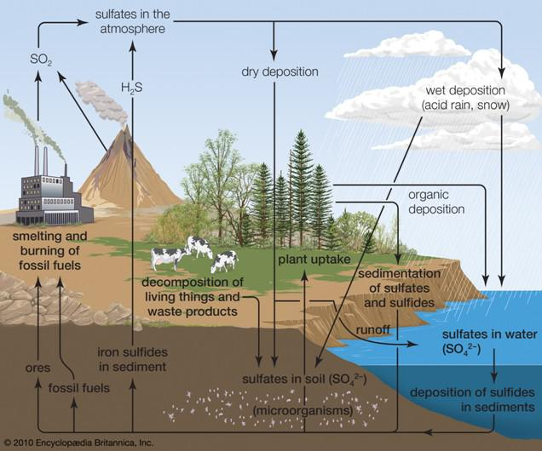

Slide 13
Terrestrial portion of Sulfur cycle:
The weathering of rocks is the 1st step to release the sulfur stored in the rocks.
Next, the Sulfur comes in contact with the air turning the sulfur into sulfate.
Then the sulfur is taken up by plants and microorganisms and converted into organic form.
Finally, animals eat those plants which introduces sulfur into the food chain.
The death and decomposition of organisms release sulfur once again in sulfate form, hydroen sulfide form and some of it becomes the part of the biomass of microoranism.
Some part of Hydrogen sulfide converted to sulfur and water by chemoautotrophic bacteria (anaerobic bacteria eg. Thiothrix) and some of hydrogen sulfide again go to atomosphere.

Slide 14
Some sulfur oxidising bacteria directly oxidizes the H2S to sulfate by thiobacillus bacteria.

